Slide 1
Hadoop DistributedGrep Example
CSC 4760 / 6760 Big Data Programming
Spring 2020
Chapter 1 Design Patterns and MapReduce. Book: MapReduce Design Patterns, Donald Miner & Adam Shook, 2012.

Slide 2
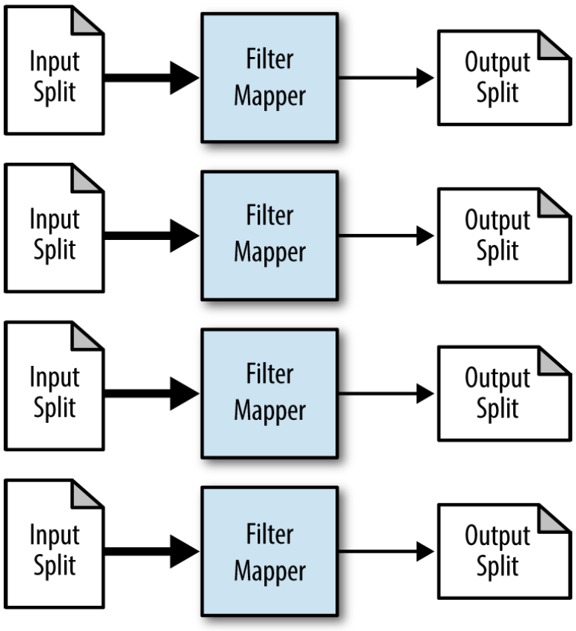
Filtering
Figure 3-1. The structure of the filter pattern, MapReduce Pattern Design
The simplest of all patterns we’ll see in the book!
map(key, record):
if we want to keep record then
emit <key, value>

Slide 3
Application of “Filtering”
Closer View of data (subset of data, something in common or of interest)
Tracking a thread of consecutive events
Distributed Grep (find regular expression to find lines of text of interests)
Data cleansing (incomplete, wrong format, dirty, junk)
Simple random sampling (each item has the same probability of being selected)
Removing low scoring data (filter out records that don’t meet a certain threshold)

Slide 4
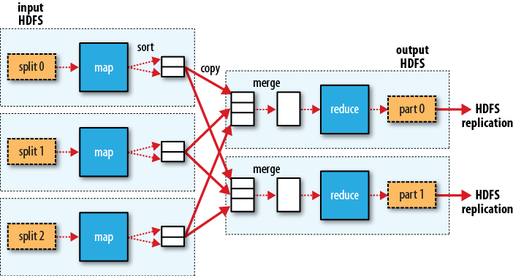
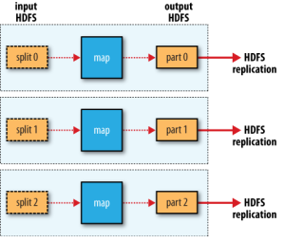

Performance
Basically as efficient as MapReduce can get.
Map-Only Hadoop program
No shuffle, no need to be transmitted between the Map and Reduce phases

Slide 5
Problem to be Solved – Distributed Grep
GREP (Global Regular Expression Print)
Grep is a popular text filtering utility that is available on most Unix-like systems
Distributed Grep:
For each line in a text file
if this line match a specific pattern then
Output this line
Scans through a file line-by-line
How to parallelize the regular expression search across a larger body of text?

Slide 6
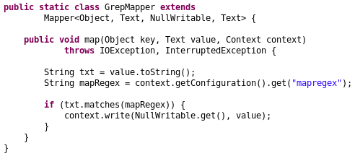
Mapper
map-only job
Source code “DistributedGrep.java”

Slide 7
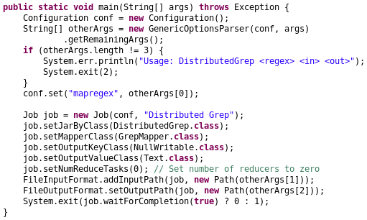
main function
Source code “DistributedGrep.java”

Slide 8
Regular Expression
Char. | Meaning
. | Any character (may or may not match line terminators)
X* | X, zero or more times
Literal Characters: a – z, A - Z
Special Characters: [ \ ^ $ . | ? * + ( )
[Gg]r[ae]y
Grayson drives a grey sedan.
hadoop command (search all the lines containing “hadoop”):
$ hadoop jar DistributedGrep.jar .*hadoop.* inputfile outputdirectory
Java function: String.matches(RegExString)
Java Regular-Expression:
https://docs.oracle.com/javase/7/docs/api/java/util/regex/Pattern.html#sum

